Slide 1


QUICK SORT USING DIVIDE AND CONQUER
DAA INDIVIDUAL PROJECT

Slide 2
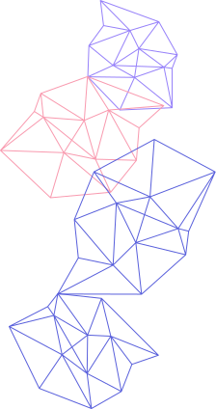
PREPARED BY
NAME : RAHIL MAIYANI
ROLL NO. : 70
ENRL NO. : 23002170110078
BATCH : A2
BRANCH : CE

Slide 3
INTRODUCTION
Sorting is a basic and important problem in DAA.
Quick Sort is one of the fastest sorting algorithms.
It uses the divide and conquer technique.
This project explains Quick Sort using algorithm steps and visual representation.
Visualization helps in understanding the internal working of the algorithm.

Slide 4
PROJECT OVERVIEW
The project demonstrates the working of Quick Sort algorithm.
User provides input numbers through a simple interface.
The algorithm processes the input step by step.
Each step is visually displayed using bars and colors.
Frontend is used only to support algorithm understanding.

Slide 5
KEY FEATURES
Accepts user-defined or randomly generated input
Step-by-step visualization of sorting process
Different colors used to indicate pivot, pointers, swaps, and fixed elements
Adjustable speed control for better observation
Pause, resume, and reset options during execution
Displays final sorted output and execution time

Slide 6
MERITS DEMERITS
Fast in average case
It Requires less extra memory
Visualization improves clarity of algorithm steps
In Worst-case time complexity is high
Performance depends on pivot choice
Recursive approach uses stack space

Slide 7
CONCLUSION
Quick Sort is an efficient divide and conquer algorithm.
This project focuses on algorithm design and analysis.
Visualization makes complex steps easy to understand.
Frontend acts as a learning aid.
The project meets both DAA learning and demonstration goals.

Slide 8
THANK
YOU!

